Slide 1
2019 CAP Month Planning Call #CAPmonth #Greatchildhoods
Every Child Deserves to grow up feeling safe and Loved!

Slide 2
Frameworks' Recommendations
The strength of our NATIONAL campaign lies in its consistent use of a few core elements.
National consistency and local creative flexibility are key for our campaign to have MAXIMUM COLLECTIVE IMPACT!
Four “must‐have” strategic elements that will lead to greater success with the campaign for all partners:
Notes:
What this really mean is: How do we move from recognizing and reporting abuse to prevent it before it ever begins.

Slide 3
(4) Core Campaign Elements
Consistent use of “Pinwheels for Prevention” name
Consistent use of the official Pinwheels for Prevention logo
Consistent use of campaign messaging
Use of the national pinwheel
Notes:
All local campaigns using materials provided by PCA Florida must use the Pinwheels for Prevention campaign name. Our director of communications is available to assist local organizations in rebranding existing campaigns to make a smooth transition to P4P without loss of campaign momentum.
The official campaign logo must be used in any graphic depictions of P4P. Creative interpretations, use of the logo in colors other than those identified in the graphic standards, or use of other pinwheel depictions in relations to the P4P campaign is not permitted. P4P logo files can be provided if needed.
While the story of prevention will vary from one community to the next, campaign organizers are expected to deliver messages that are consistent with the research on furthering the message of child abuse prevention provided by Frameworks.
Purchase or use of pinwheels is not a requirement; however, organizers wishing to use pinwheels for their campaign events must use the official national pinwheel.

Slide 4
Sample Campaign Messages
Use “social math” instead of saying your program served 2000 children last year, you could say “…that’s enough to fill 27 school buses!”
Feature local stories of people who have found ways to make a difference.
Talk about the importance of healthy child development and the important role of businesses as partners in assuring safe, stable, nurturing relationships and environments in the home, community, and workplace.
Give specific examples of actions individuals, businesses and others can take to prevent abuse/neglect (See 10 Things you can do to prevent Abuse/Neglect at PCAF)*
Equate pinwheels with positive messages of ensuring nurturing relationships and healthy home environments.
Notes:
There is nothing wrong with statistics, but if you do not look behind them, they can become a meaningless embellishment. If someone asks for specific numbers, use “social math” to make the numbers more meaningful to the audience. For example, instead of saying your program served 1000 children last year, you could say your program served one of every three kids in the community or the equivalent of all the students at one local elementary school.
Your audience realizes child abuse and neglect is a big problem and feels helpless to make a difference. By featuring compelling stories of people who have found ways to make a difference, you empower your audience to take action and make a difference in their own families and communities.
Talk about the community and how it can support children and families in need to succeed and common situations that can lead to abuse and neglect in the community (skyrocketing unemployment, the growing number of homeless families, lack of affordable quality child care, lack of mental health services, underfunded schools, libraries and parks etc.)
Child development is a foundation for community development and economic development as our children are the foundation for the future of our society. Child abuse damages the developing brain and leads to learning and behavioral problems as well as increased risk for long-term physical and mental illness. Effective child development efforts (such as home visiting, treatment for maternal depression, SBS awareness, healthy sexual development and bullying prevention programs etc.) lay a strong foundation for a child’s successful growth and development while reducing the long-term costs to society (crime, the cycle of abuse, health care, poor education, lost productivity etc.)
Ask businesses, schools, religious and civic organizations, early learning providers, parents, media outlets and others to participate in specific ways like making donations, organizing volunteer activities, distributing materials to parents etc.
Pinwheels can be used to represent the # of healthy births in your community during a period of time, the # of children entering Kindergarten at a local school, the # of children or families served a by a local program, etc. The pinwheels can also be associated with a more general message of support for the prevention of child abuse and neglect. The pinwheels should never be used to illustrate the # of children injured or killed from child abuse and neglect or the # of reported cases of abuse and neglect.

Slide 5
How to: Spread the Word
Please see the “Toolkit” https://www.ounce.org/CAP_toolkit.html for examples:
1. Media
Sample Press Release (See Toolkit Above)
Sample Proclamation
Sample Letter to the Editor
Opinion Editorial
Social Media - Download the High Res Zip File to get all the social media images here: https://www.ounce.org/CAP_toolkit.html
Notes:
Our office receives many inquiries regarding local events taking place throughout Florida in recognition of Child Abuse Prevention Month. Posting your local event to our website allows us to easily share information with volunteers and community members. Please use the form located on the OPFF’s website under this link.
Working with the media is a great way to inform your community about your campaign to prevent CAN. News media generally publicize community events free of charge through their community calendars. As you prepare to launch your local campaign, it is important that you identify a campaign spokesperson; someone who is familiar with your local prevention efforts and has experience working with the media would be ideal. Identifying a key campaign contact for the media ensures both good media relations and consistent delivery of key campaign messages. We can provide a contact list for Florida media outlets if needed.

Slide 6
Florida Focus
Florida will continue our “Pinwheels for Prevention Tour” in addition to partnerships focusing on raising awareness through highly visible campaign events.
Hashtags for this year
#Greatchildhoods
#Pinwheelsforprevention
#CAPmonth
#wearblue

Slide 7
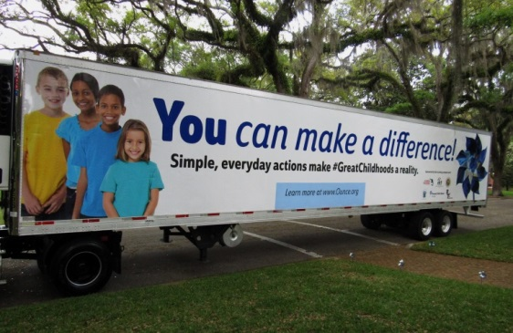
#Pinwheel #Greatchildhoods
Statewide Kickoff Event – TBA
A few weekdays are still available for the 2019 Pinwheels for Prevention Tour! (Contact Chris for dates available.)
See the complete list of Tour Stops at: https://www.ounce.org/capevents.asp
Pinwheel Facebook Photo Contest: Prizes for Most Creative, and Best Events in a large and small market! Prizes will be awarded in May!

Slide 8
#PinwheelsforPrevention
Want more info? Check us out on Facebook!
Contact us! Chris Lolley
(850) 921-3271 - cell
clolley@ounce.org
Jennifer Hartshorne:
(850) 921-4494, ext. 209
jhartshorne@ounce.org

